Slide 1


Slide 2

What is recursion?
Examples of recursion
Advantages and Disadvantages

Slide 3

Sometimes, the best way to solve a problem is by solving a smaller version of the exact same problem first
Recursion is a technique that solves a problem by solving a smaller problem of the same type
A procedure that is defined in terms of itself

Slide 4

A simple example of a recursively defined function is the factorial function:
n! = 1· 2· 3· 4 ···(n –2)·(n –1)·n
i.e., the product of the first n positive numbers (by convention, the product of nothing is 1, so that 0! = 1).
Q: Find a recursive definition for n!
L16

Slide 5

n! = 1 if n==0
n != n * (n -1) * n-2* ……1 if n>0
To compute the value of 5!
0! = 1
1! = 1
2! = 2*1
3! = 3*2*1
4! = 4*3*2*1
5! = 5*4*3*2*1
………….
L16

Slide 6
We can define
0! = 1
1! = 1 * 0!
2! = 2 * 1!
3! = 3 * 2!
4! = 4 * 3!
5! = 5 * 4!
Mathematically
n! = 1 if n==0
n != n * (n -1) * n-2* ……1 if n>0

Slide 7

To compute the value of a recursive function, e.g. 5!, value of 4! is required. For 4! Value of 3! Is required.
EG: 5! = 5 · 4! = 5 · 4 · 3!
recursion

Slide 8

recursion
EG: 5! = 5 · 4! = 5 · 4 · 3! = 5 · 4 · 3 · 2!
EG: 5! = 5 · 4! = 5 · 4 · 3! = 5 · 4 · 3 · 2!
= 5 · 4 · 3 · 2 · 1!
recursion

Slide 9
EG: 5! = 5 · 4! = 5 · 4 · 3! = 5 · 4 · 3 · 2!
= 5 · 4 · 3 · 2 · 1! = 5 · 4 · 3 · 2 · 1 · 0!
0! = 1
1! = 1 * 0! = 1* 1 = 1
2! = 2 * 1! = 2* 1 = 2
3! = 3 * 2! = 3* 1 = 6
4! = 4 * 3! = 4* 6 = 24
5! = 5 * 4! = 5* 24 = 120
recursion

Slide 10

if (n==0)
fact = 1;
else
{
x = n-1;
find the value of x!, call it y;
fact = n*y;
}
n! = 1 if n==0
n != n * (n -1) * n-2* ……1 if n>0

Slide 11

A recursive method generally has two parts.
  A termination part that stops the recursion.
    This is called the base case.
    The base case should have a simple or trivial solution.
  One or more recursive calls.
    This is called the recursive case.
    The recursive case calls the same method but with simpler or smaller arguments.

Slide 12

int factorial(int n)
{
int x, y;
if (n == 0)
return 1;
x = n-1;
y = factorial(x);
return n * y;
}
Base case
Recursive case deals with a simpler (smaller) version of the task

Slide 13
int factorial(int n)
{
int x, y;
if (n == 0)
return 1;
x = n-1;
y = fact(x);
return n * y; // return n * fact(n-1);
}
public static void main(String args[])
{ int n;
System.out.println("Factorial is " + factorial(4));
}

Slide 14

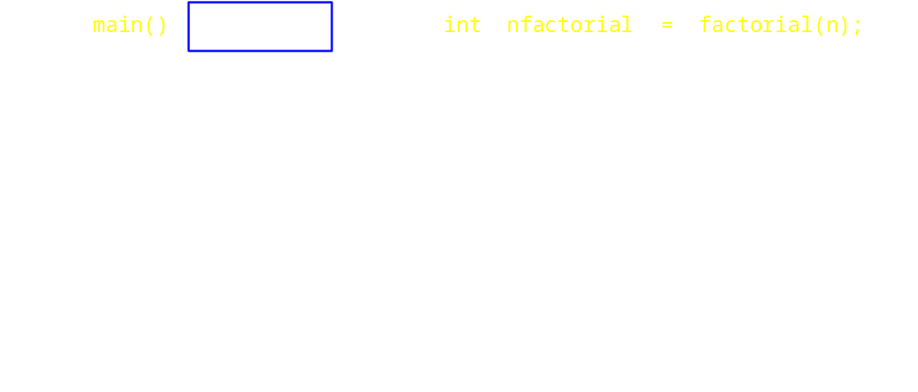
A new activation record is created for every function invocation
  Including recursive invocations

Slide 15
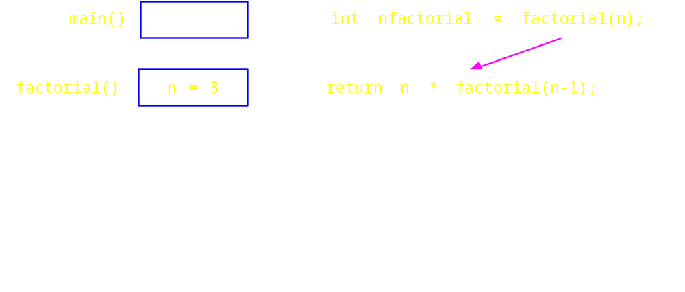
A new activation record is created for every function invocation
  Including recursive invocations

Slide 16
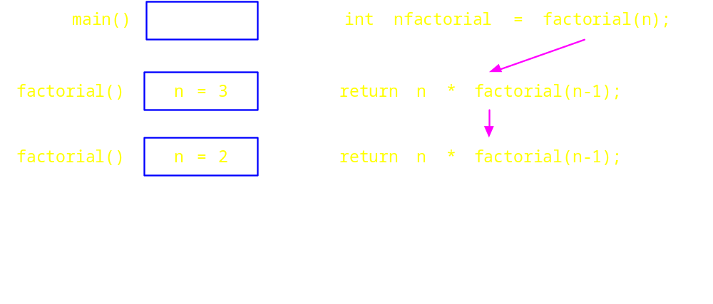
A new activation record is created for every function invocation
  Including recursive invocations

Slide 17
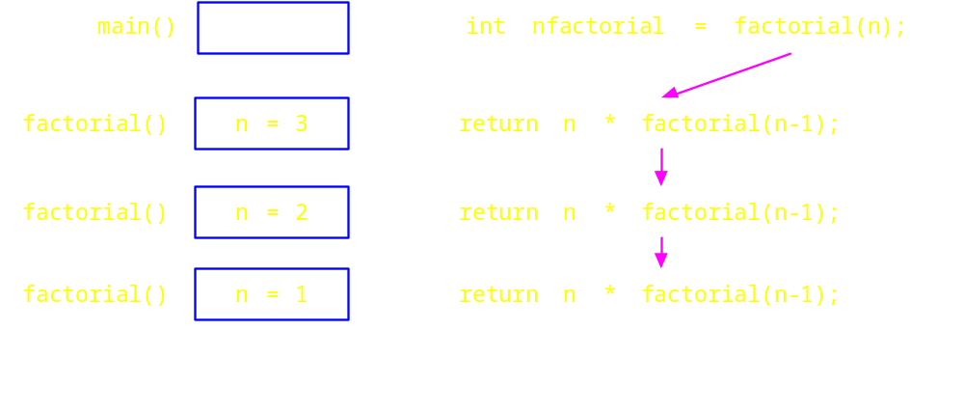
A new activation record is created for every function invocation
  Including recursive invocations

Slide 18
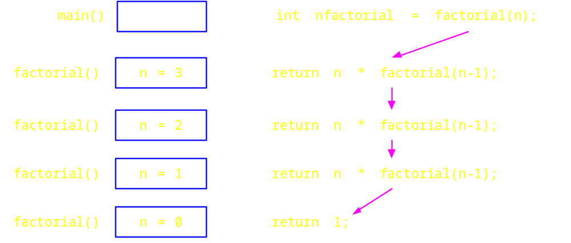
A new activation record is created for every function invocation
  Including recursive invocations

Slide 19
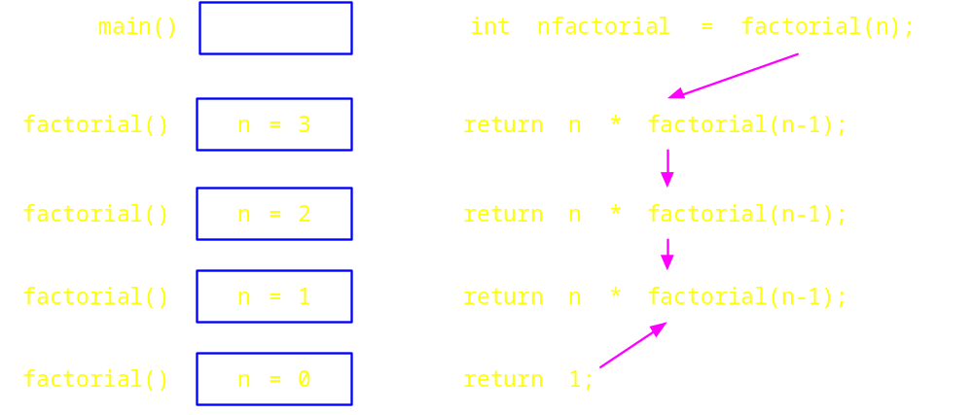
A new activation record is created for every function invocation
  Including recursive invocations

Slide 20
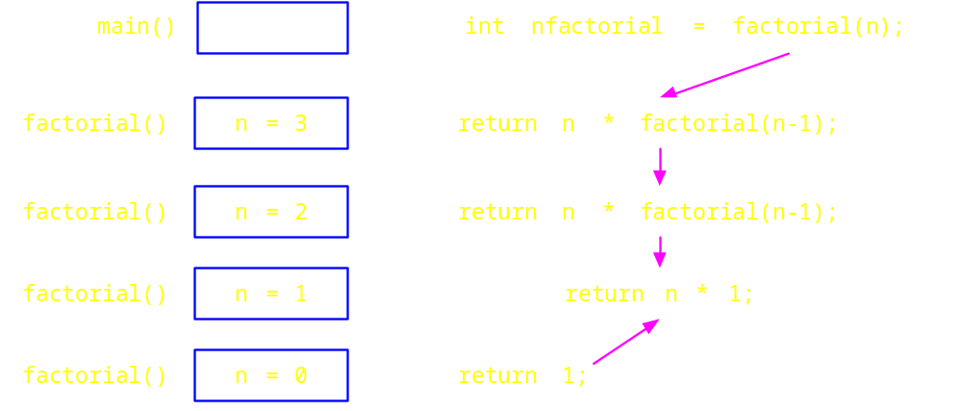
A new activation record is created for every function invocation
  Including recursive invocations

Slide 21
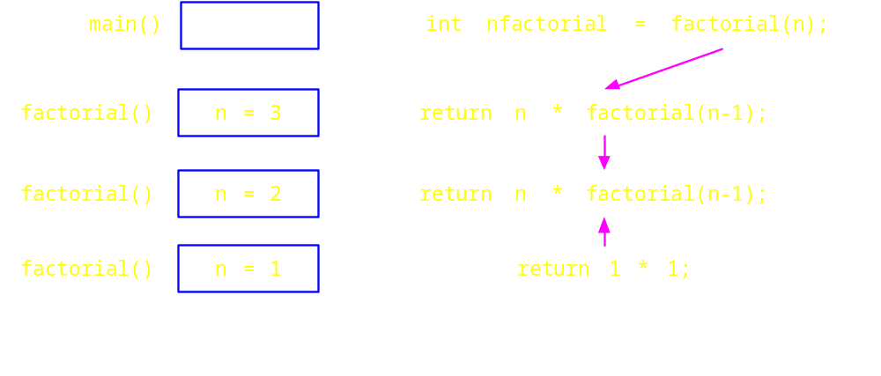
A new activation record is created for every function invocation
  Including recursive invocations

Slide 22
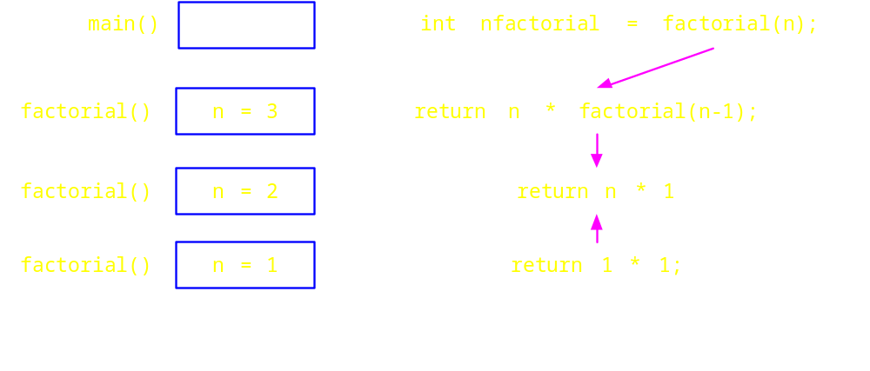
A new activation record is created for every function invocation
  Including recursive invocations

Slide 23
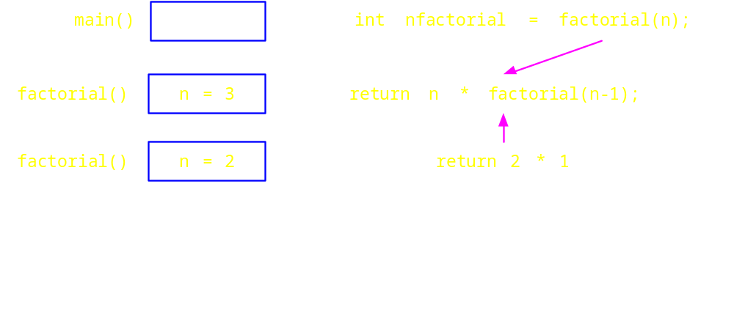
A new activation record is created for every function invocation
  Including recursive invocations

Slide 24
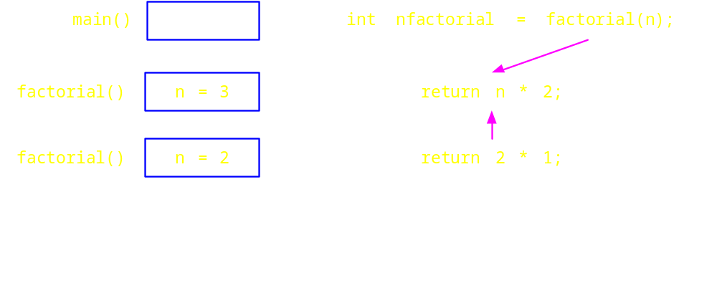
A new activation record is created for every function invocation
  Including recursive invocations

Slide 25
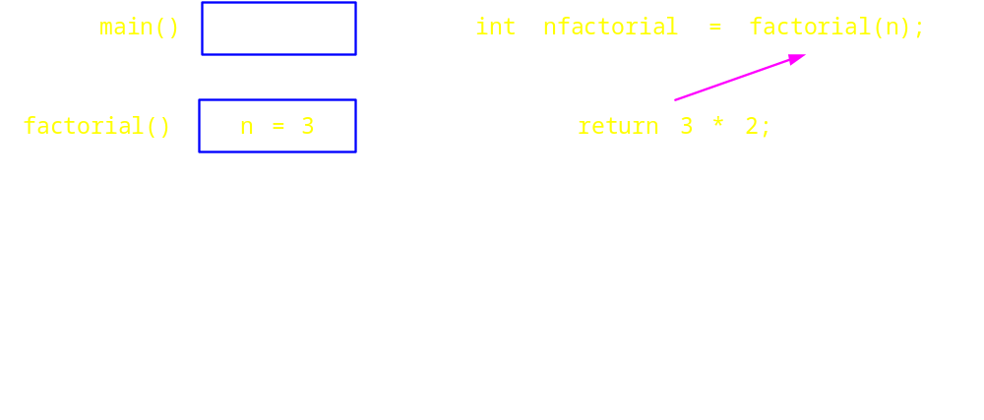
A new activation record is created for every function invocation
  Including recursive invocations

Slide 26
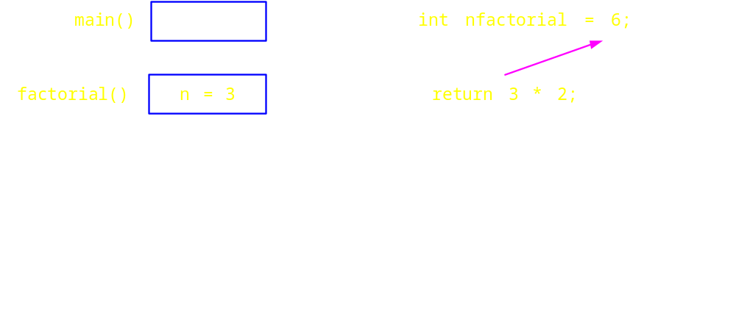
A new activation record is created for every method invocation
  Including recursive invocations

Slide 27
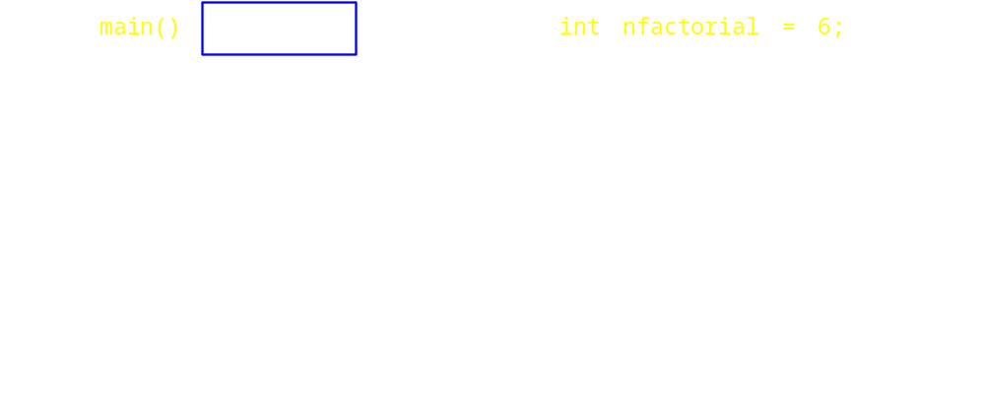
A new activation record is created for every method invocation
  Including recursive invocations

Slide 28

Recursive definition of multiplication is
a * b = a if b==1 // stopping state
a * b = a * (b -1) + a if b>1
For Example
6*3 = 6*2+6 = 6*1+6+6 = 6+6+6 = 18

Slide 29

int mult(int a, int b)
{
int x, y;
if (b==1 )
return a;
else
y = b-1;
x = mult(a,y);
return a+x;
}

Slide 30

The sequence generated is:0, 1, 1, 2, 3, 5, 8, 13, 21, 34, …
The next number is the sum of the previous two numbers
fib(n) = n if n==0 or n==1
Fib(n) = fib(n-1) + fib(n - 2) if n>=2

Slide 31

int fib(int n)
{
int x,y;
if (n<=1)
return n;
x = fib(n-1);
y = fib(n-2);
return x + y;
}

Slide 32
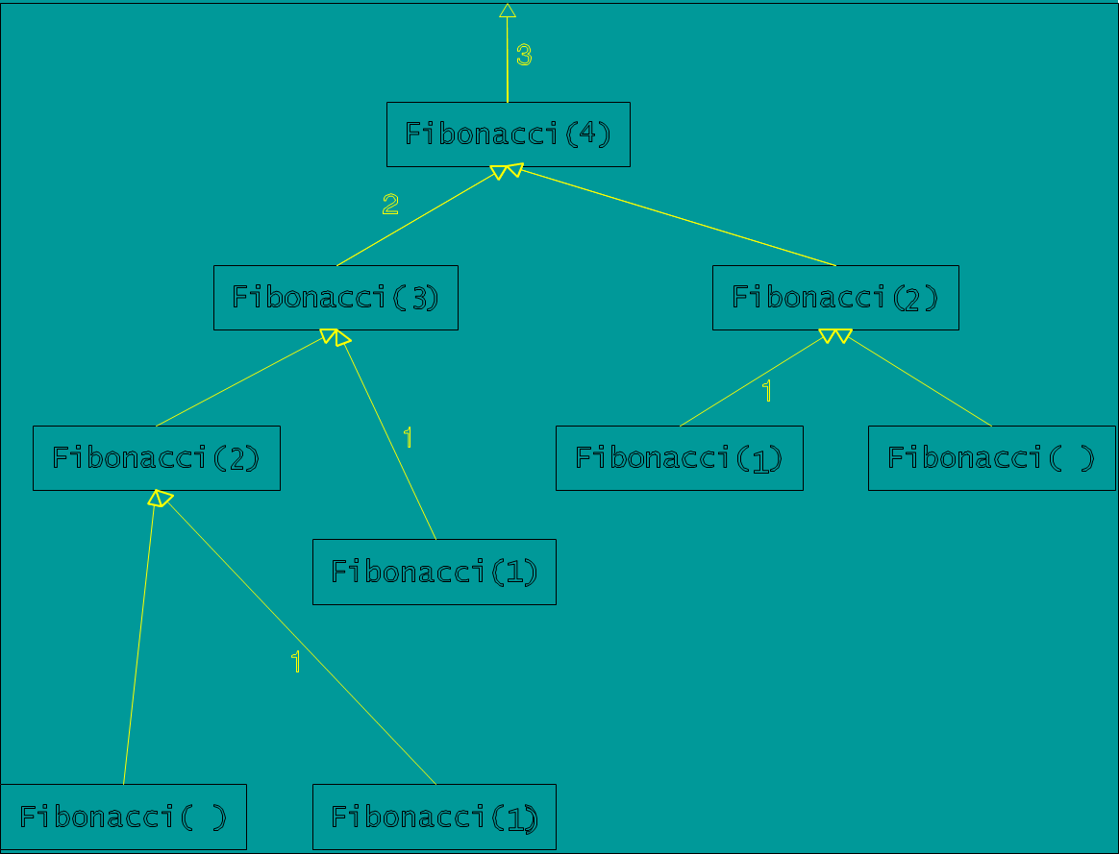

Slide 33


A common programming error when using
recursion is to not stop making recursive calls.
  The program will continue to recurse until
  it runs out of memory.
  Be sure that your recursive calls are made with simpler or smaller subproblems, and that your algorithm has a base case that terminates the recursion.

Slide 34
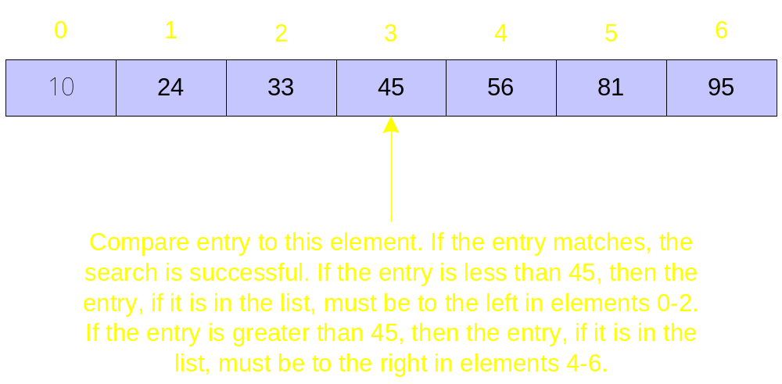
Compare the entry to the middle element of the list. If the entry matches the middle element, the desired entry has been located and the search is over.
If the entry doesn’t match, then if the entry is in the list it must be either to the left or right of the middle element.
The correct sublist can be searched using the same strategy.

Slide 35

int binsrch(int a[], int x, int low, int high)
{
int mid;
if (low > high)
return (-1);
mid = (low + high)/2;
if (x == a[mid])
return mid;
else if (x < a[mid])
binsrch(a, x, low, mid-1);
else
binsrch(a, x, mid+1, high);
}

Slide 36

Legend has it that there were three diamond needles set into the floor of the temple of Brahma in Hanoi.
Stacked upon the leftmost needle were 64 golden disks, each a different size, stacked in concentric order:

Slide 37

The disks are to be moved from the first needle to the second needle, using the third as necessary.
But only move one disk at a time, and could never put a larger disk on top of a smaller one.
When they completed this task, the world would end!

Slide 38

For simplicity, suppose there were just 3 disks, and we’ll refer to the three needles as A, B, and C...
Since we can only move one disk at a time, we move the top disk from A to B.

Slide 39

For simplicity, suppose there were just 3 disks, and we’ll refer to the three needles as A, B, and C...
We then move the top disk from A to C.

Slide 40

For simplicity, suppose there were just 3 disks, and we’ll refer to the three needles as A, B, and C...
We then move the top disk from B to C.

Slide 41
For simplicity, suppose there were just 3 disks, and we’ll refer to the three needles as A, B, and C...
We then move the top disk from A to B.

Slide 42
For simplicity, suppose there were just 3 disks, and we’ll refer to the three needles as A, B, and C...
We then move the top disk from C to A.

Slide 43
For simplicity, suppose there were just 3 disks, and we’ll refer to the three needles as A, B, and C...
We then move the top disk from C to B.

Slide 44
For simplicity, suppose there were just 3 disks, and we’ll refer to the three needles as A, B, and C...
We then move the top disk from A to B.

Slide 45
For simplicity, suppose there were just 3 disks, and we’ll refer to the three needles as A, B, and C...
and we’re done!
The problem gets more difficult as the number of disks increases...

Slide 46

Today’s problem is to write a program that generates the instructions for the priests to follow in moving the disks.
While quite difficult to solve iteratively, this problem has a simple and elegant recursive solution.

Slide 47

Our task, then is to write function Move() that does all the work:
void Move(int n, char src, char dest, char aux);
Public static void main()
{
int numDisks;
System.out.println (“Enter how many disks: “;
Scanner in = new Scanner(System.in);
numDisks = in.nextInt();
Move(numDisks, ‘A’, ‘B’, ‘C’);
}

Slide 48

Basis: What is an instance of the problem that is trivial?
→ n == 1
Since this base case could occur when the disk is on any needle, we simply output the instruction to move the top disk from src to dest.

Slide 49
Basis: What is an instance of the problem that is trivial?
→ n == 1
Since this base case could occur when the disk is on any needle, we simply output the instruction to move the top disk from src to dest.

Slide 50

Induction Step: n > 1
→ How can recursion help us out?
a. Recursively move n-1 disks from src to aux.

Slide 51
Induction Step: n > 1
→ How can recursion help us out?
b. Move the one remaining disk from src to dest.

Slide 52
Induction Step: n > 1
→ How can recursion help us out?
c. Recursively move n-1 disks from aux to dest...

Slide 53
Induction Step: n > 1
→ How can recursion help us out?
d. We’re done!

Slide 54

We can combine these steps into the following algorithm:
  0. Receive n, src, dest, aux.
  1. If n > 1:
  a. Move(n-1, src, aux, dest);
  b. Move(n, src, dest, aux);
  c. Move(n-1, aux, dest, src);
  Else
  Display “Move the top disk from “, src, “ to “, dest.
  End if.

Slide 55

// ...
void Move(int n, char src, char dest, char aux)
{
if (n > 1)
{
Move(n-1, src, aux, dest);
System.out.println("Move disk "+ n + "from " + src + "to " + dest);
Move(n-1, aux, dest, src);
}
else
System.out.println("Move the top disk from "
+ src + " to " + dest);
}

Slide 56

The Hanoi Towers
Enter how many disks: 1
Move the top disk from A to B

Slide 57

The Hanoi Towers
Enter how many disks: 2
Move the top disk from A to C
Move the top disk from A to B
Move the top disk from C to B

Slide 58
The Hanoi Towers
Enter how many disks: 3
Move the top disk from A to B
Move the top disk from A to C
Move the top disk from B to C
Move the top disk from A to B
Move the top disk from C to A
Move the top disk from C to B
Move the top disk from A to B

Slide 59
The Hanoi Towers
Enter how many disks: 4
move a disk from needle A to needle B
move a disk from needle C to needle B
move a disk from needle A to needle C
move a disk from needle B to needle A
move a disk from needle B to needle C
move a disk from needle A to needle C
move a disk from needle A to needle B
move a disk from needle C to needle B
move a disk from needle C to needle A
move a disk from needle B to needle A
move a disk from needle C to needle B
move a disk from needle A to needle C
move a disk from needle A to needle B
move a disk from needle C to needle B

Slide 60

Recursion is a valuable tool that allows some problems to be solved in an elegant and efficient manner.
Functions can sometimes require more than one recursive call in order to accomplish their task.
There are problems for which we can design a solution, but the nature of the problem makes solving it effectively uncomputable.

